Slide 1

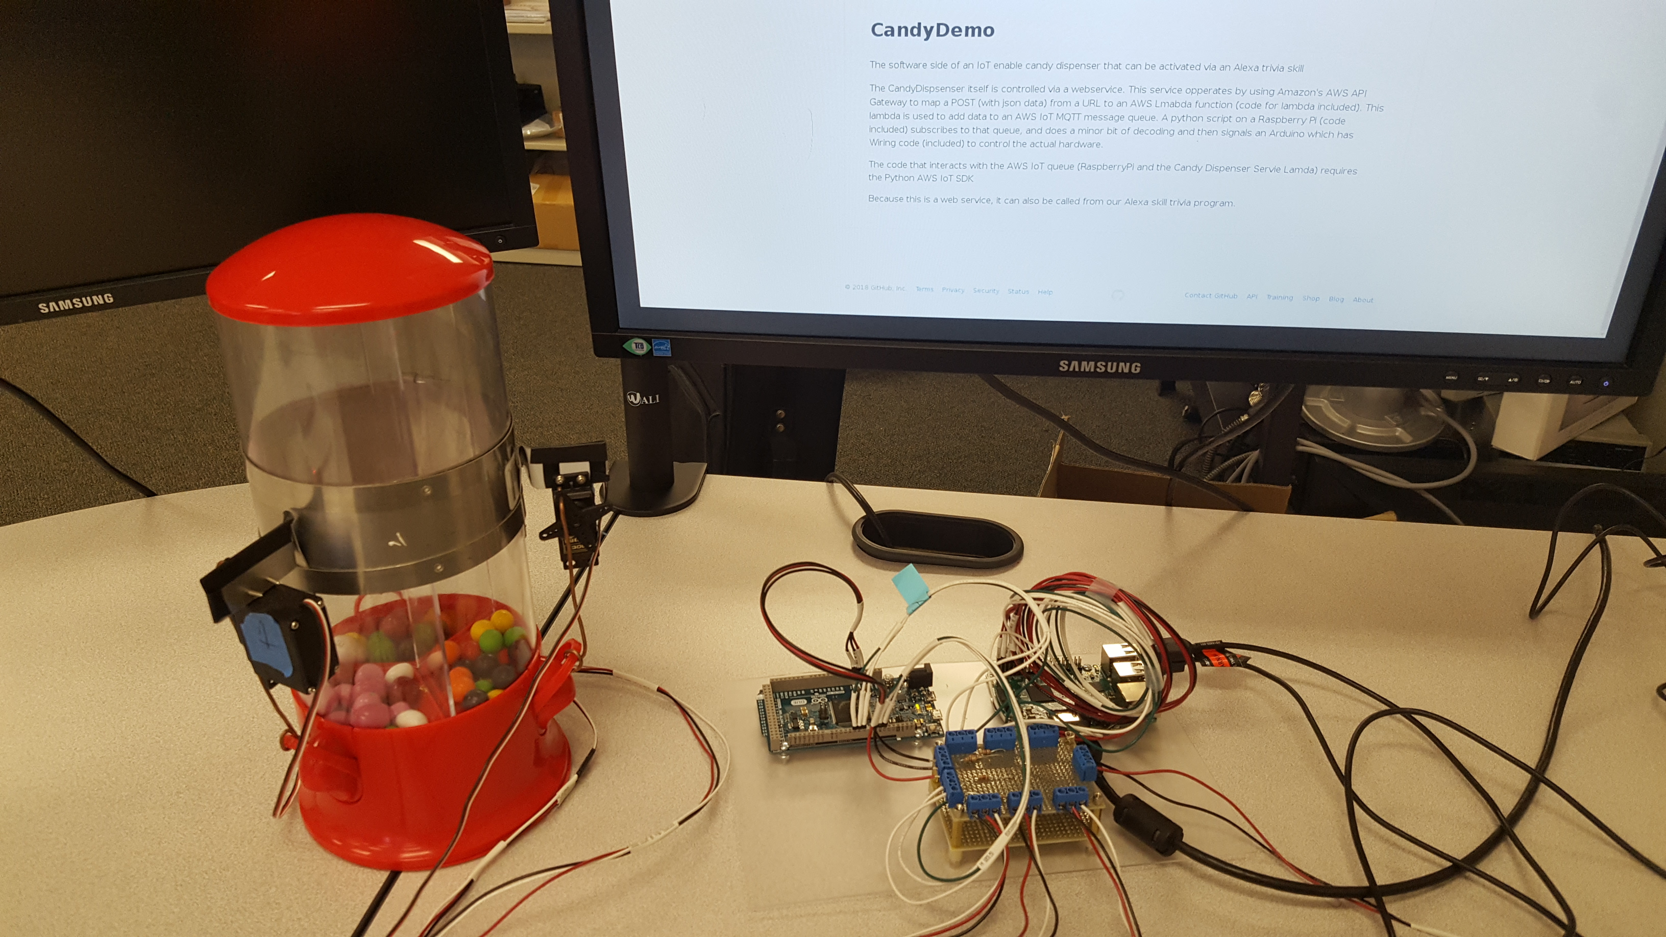
CandyTron
An Alexa/AWS/RaspberryPi/Arduino Technology Demo, - with Candy.
Ryan Powers, Tim Massaro

Slide 2
Alexa Trivia Skill
(or)
Simple Test Webpage
AWS API Gateway
AWS Lambda based web service
AWS InternetOfThings
RaspberryPi
Arduino
Candy Dispenser Hardware
Candy

Slide 3

Trivia Alexa Skill
“Skill” – any voice-driven application for the Amazon Echo/Dot/Show or Tap. Check the weather, stream music, turn on lights, order pizza…
Amazon supplies demos to get Skill writers started, including Build-a-Trivia-Skill-in-under-an-Hour <= I started here.
Modified the skill to become Minnesota Fun Facts Trivia and published it. If you have an Alexa, try it out!
For CandyTron, I modified it again, added an http call to the AWS API (not this is only on my personal Amazon account). The invocation phrase is: “Candy Demo”

Slide 4
Simple Test Webpage
Very simple webpage allowing us to call the web service easily without the need to run an Alexa Skill.
Hosted on AWS Simple Storage Service (S3) and served up as a static page
http://candydemo.s3-website-us-west-2.amazonaws.com/

Slide 5
AWS API Gateway
Maps an incoming request to the appropriate resource
In this case the request is a POST to https://qqv7kisnze.execute-api.us-west-2.amazonaws.com/test/openCandy with a JSON body
Body of the request {"candyType": “bin2" }
This gets mapped to the openCandy AWS Lambda function

Slide 6
AWS Lambda -- OpenCandy
OpenCandy is written in Python
Accepts the JSON input sent as the body of the POST request
Strips out the CandyType data, and adds that to the AWS IoT MQTT queue
Source available in repository. It is largely based on the sending half of a python demo program provided as part of the AWS IoT SDK (https://github.com/SaturnGrandRapids/CandyDemo)
A range of monitoring options are available

Slide 7
AWS Internet of Things
We used the MQTT Queue, an AWS “IoT thing” (device) shadow would also be an option
This queue is what connects the AWS Lambda service with the Raspberry Pi hardware.
SDKs are available for a range of platforms

Slide 8
Raspberry PI
Used this in addition to the Arduino because of the built in networking capabilities
Python code using the AWS IoT SDK
Subscribes to the AWS IoT MQTT queue, and listens for message
Turns on one of three GPIO pins depending on which bin candy is to be dispensed from

Slide 9
Arduino
Controls the actual servos. Servo control from a Raspberry Pi is problematic without additional hardware
Sends servo PWM control signals to one of three output pins based on the state of three input pins
Used Arduino IDE so written in Wiring (essentially simplified C++ with a collection of libraries useful for hardware tinkering)

Slide 10
Candy Dispenser Hardware
Cheap eBay candy dispenser
3 servos
Each servo goes from one extreme to the other, with a pause in the middle when it is signaled to dispense candy

Slide 11
